Slide 1


HydroDesktop: A Key Component of the CUAHSI/CZO HIS for Hydrologic Data Discovery, Visualization, and Analysis
Daniel P. Ames, Ph.D. P.E.
Idaho State University
With Jiří Kadlec, Jeff Horsburgh, Yang Cao, and many others…

Slide 2
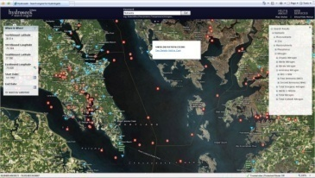

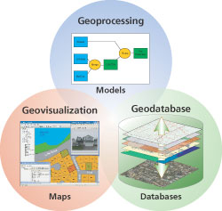
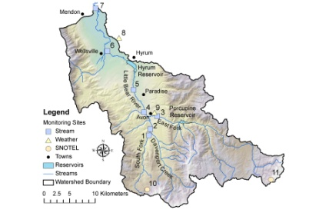
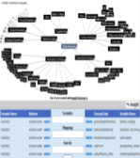
Where does HydroDesktop Fit in CUAHSI HIS?
Discovery
Access
Modeling
Analysis
Hydroseek
HydroDesktop
HydroLink + OpenMI
MATLAB, Excel, GIS, R, …
Web services and Schema
WaterOneFlow and WaterML
GetSites
GetSiteInfo
GetVariableInfo
GetValues
to transmit hydrologic data in a standard way
Observatories
Data repository
Service Registry
3rd-Party Servers
publication and archival of field data
HIS Server
HIS Central
catalog hydrologic data services and metadata
include data from others
ODM
store and share hydrologic data
An internet based system to support the sharing of hydrologic data comprising databases connected using the internet through web services as well as software for data discovery, access and publication.
Notes:
The CUAHSI Hydrologic Information System (CUAHSI-HIS) provides web services, tools, standards and procedures that enhance access to more and better data for hydrologic analysis.
The web services use an XML based format for communicating hydrologic data, called WaterML. HIS web services support access to National Datasets such as the USGS National Water Information System (NWIS) and EPA Storage and Retrieval System (STORET), in a standard way. Users anywhere with access to the internet can save their data in a relational database format, called ODM, and register it with CUAHSI HIS to publish their data. Popular software for working with data, such as Excel, MATLAB and a variety of computer programming languages can access HIS data directly using web services. This lets users work with familiar software rather than having to learn something new.

Slide 3




Where does HydroDesktop Fit in HIS
Internet based system to support the sharing of hydrologic data comprised of hydrologic databases and servers connected through web services and software for data publication, discovery and access.
Metadata
CUAHSI
HIS
Sharing hydrologic data
Data Discovery and Integration
HIS Central
Data
Analysis
HydroServer
WaterML
GML
OGC Services
HydroDesktop
Data Publication
Data Synthesis and Research
ODM
Geo Data
Support
EAR 0622374

Slide 4
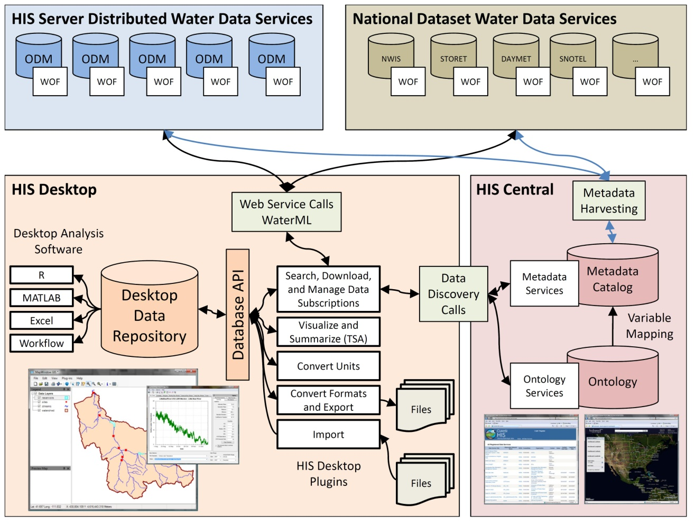
Notes:
HydroDesktop will be a key component of the HIS Project and serves as a desktop client to provide access to HIS Services. HydroDesktop will include capabilities for data discover, download, visualization, modification and export through a simple open source GIS based desktop application.

Slide 5
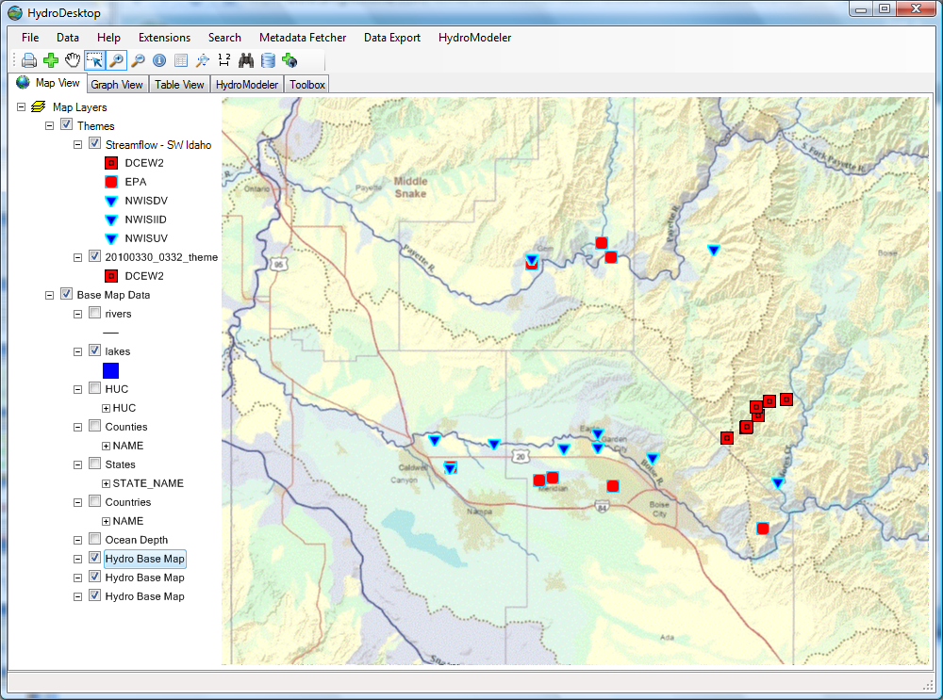

CZO Data System Overview
CZO Central
CZO HydroDesktop
GetSites
GetSiteInfo
GetVariableInfo
GetValues
WaterML
Data Store
WaterOneFlow
Web Service
Harvester
ASCII text
Standardized web based display
Boulder
Shale
Sierra
Luquillo
Jemez
Christina
CZO Servers

Slide 6

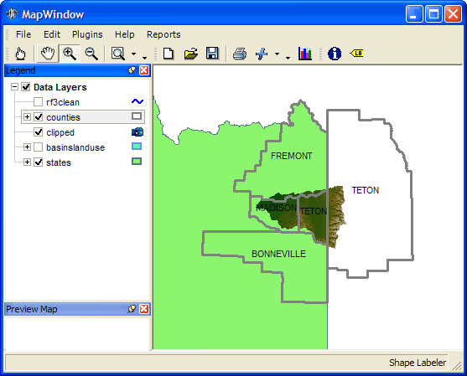







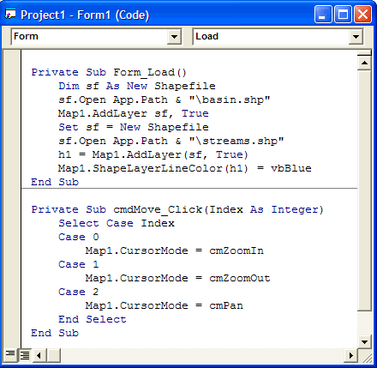

How Open Source Works
HIS
INRA
CZO

Slide 7
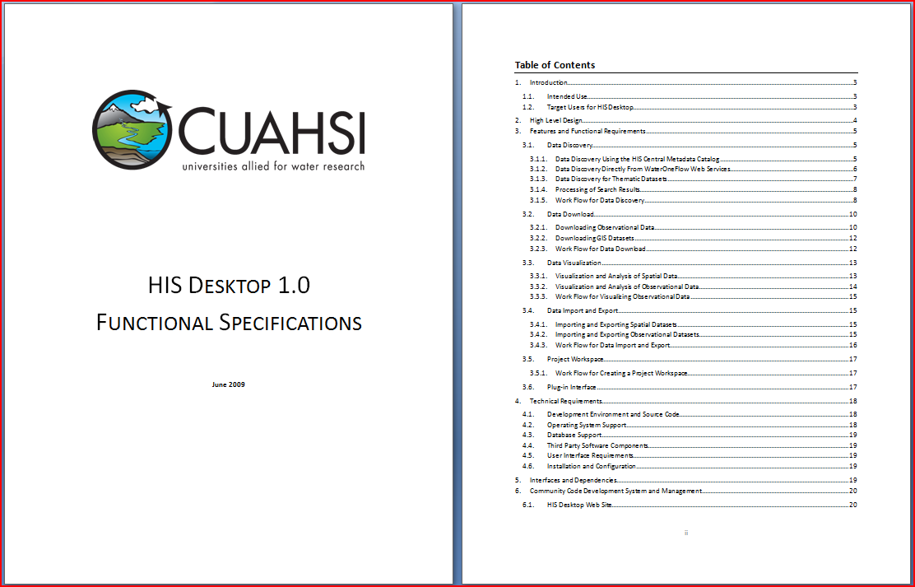
HydroDesktop Design Specifications available at www.hydrodesktop.org

Slide 8
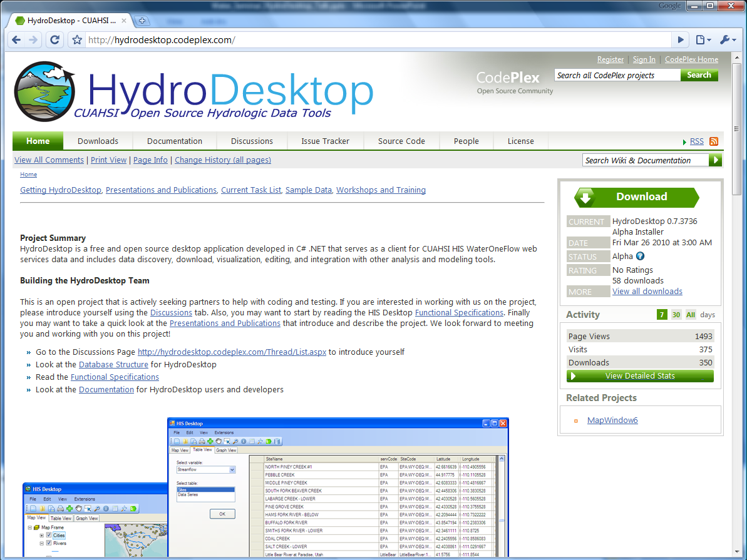

Slide 9
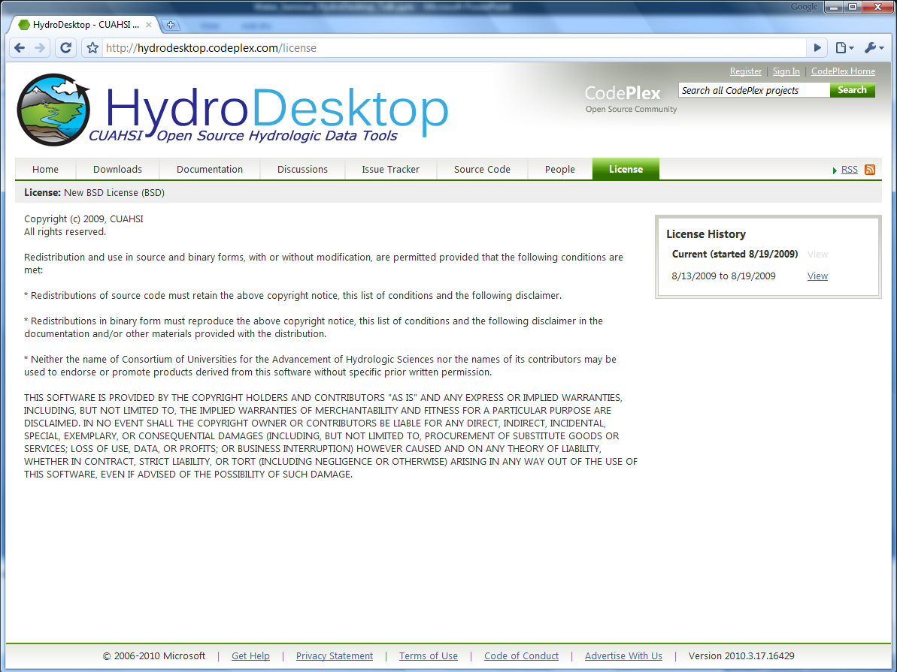

Slide 10
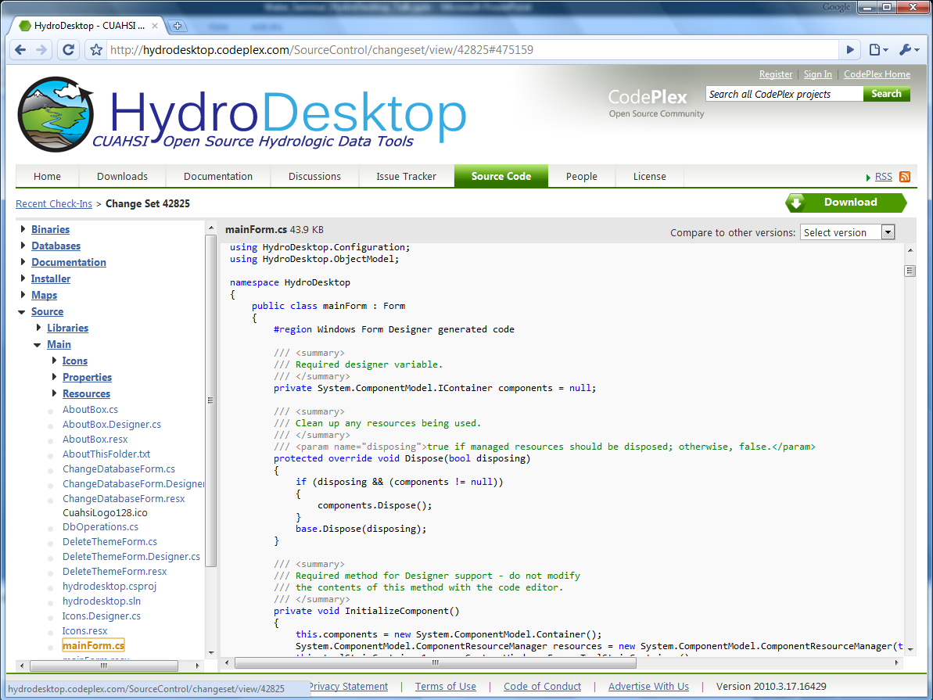

Slide 11
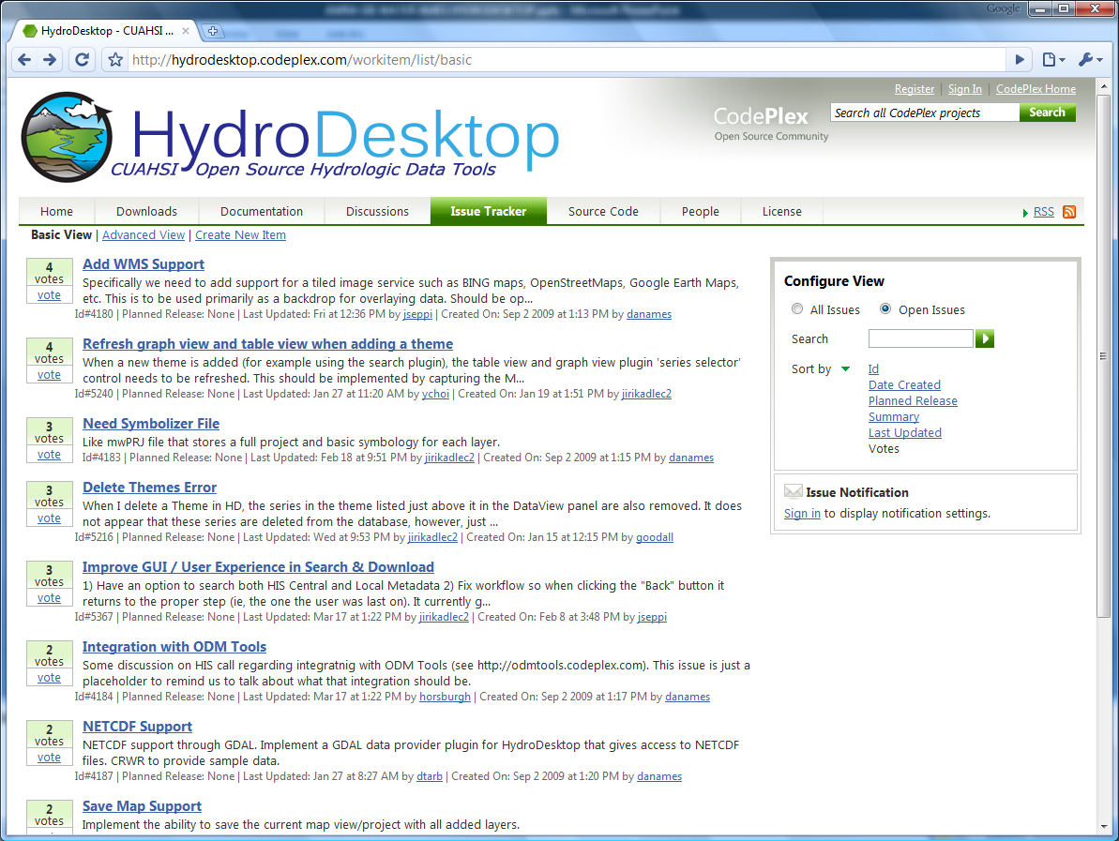

Slide 12
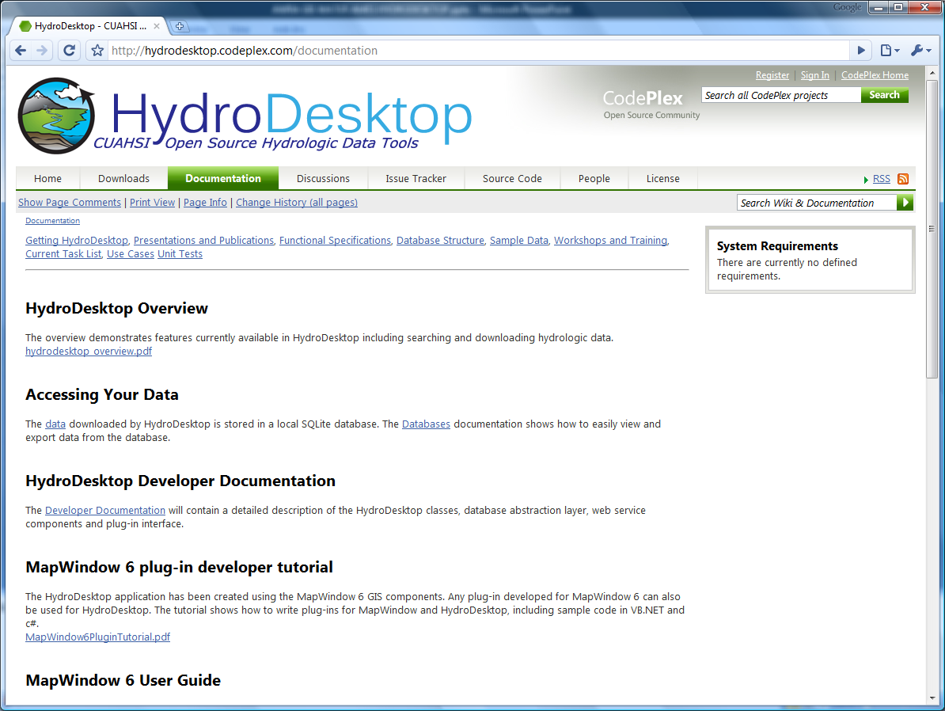

Slide 13
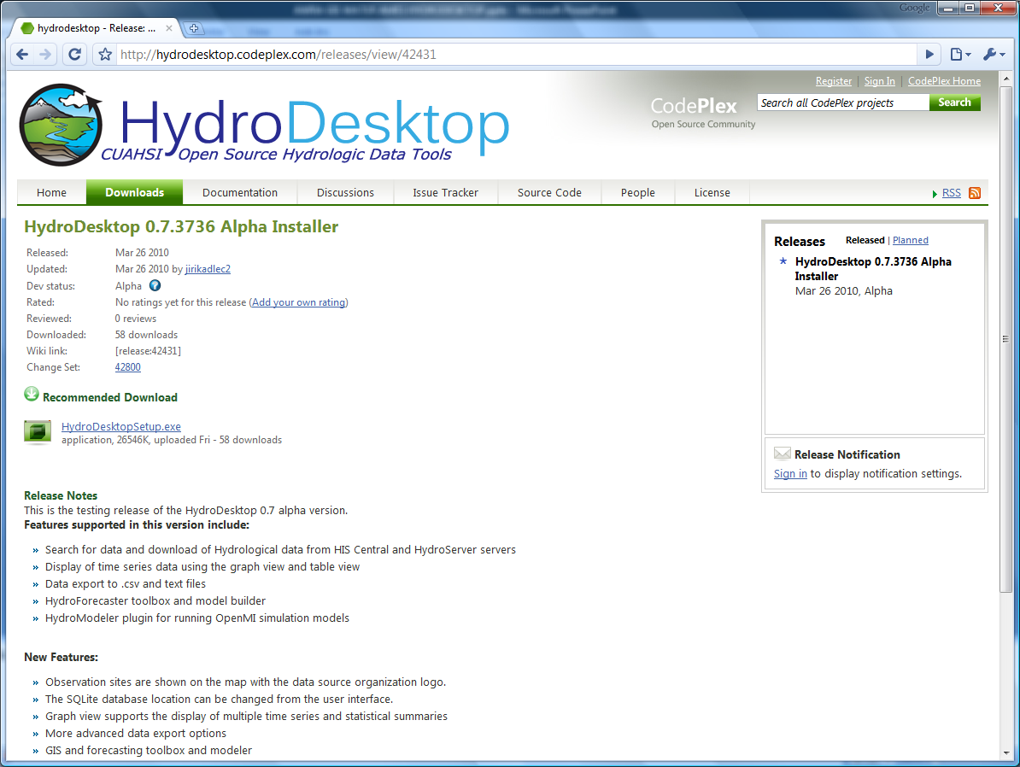
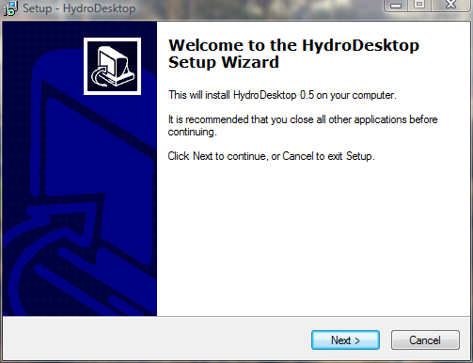

Slide 14
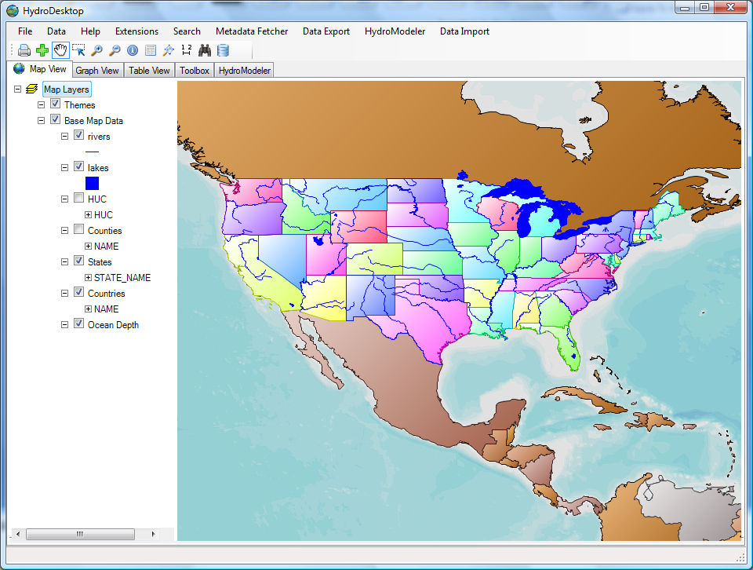

Made with…

Slide 15
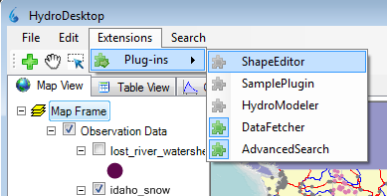
HydroDesktop Plug-in Development
Plugins
HydroDesktop.exe
AdvancedSearch.dll
HydroModeler.dll
DataFetcher.dll
MapWindow.dll
HydroDesktop.Database.dll
See “Documentation” Link on hydrodesktop.codeplex.com to learn how to write a plug-in.
Existing plugins
Search and Download
Graph View
Data Export
Metadata Fetcher
HydroModeler (Open MI)
Notes:
The functionality of HydroDesktop can be extended by plug-ins. Each plug-in needs to reference the library MapWindow.dll and implement the MapWindow 6 plugin interface. Any existing MapWindow 6 GIS plug-in can be used as a HydroDesktop plug-in. To easily access data from the HydroDesktop local database, a plugin can use functions from the HydroDesktop.Database.dll library (data abstraction layer)

Slide 16
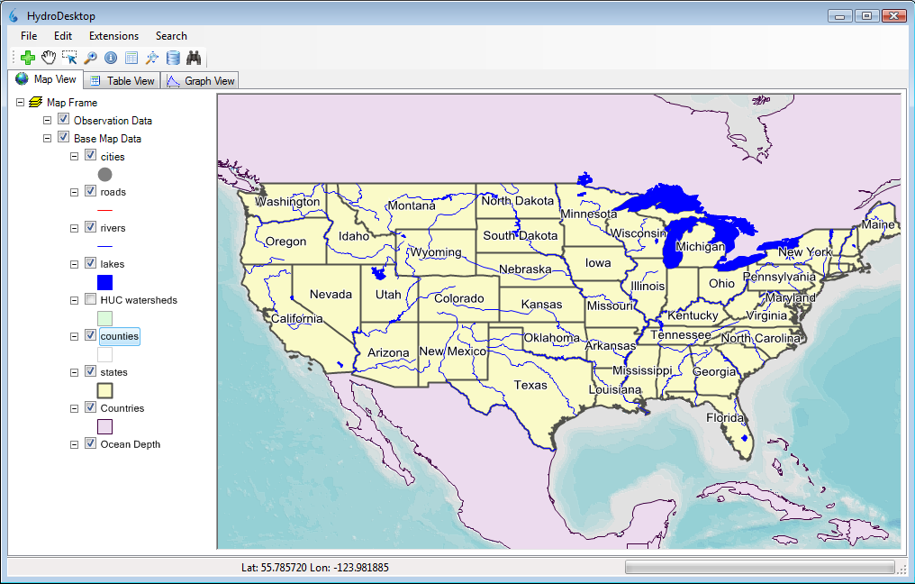
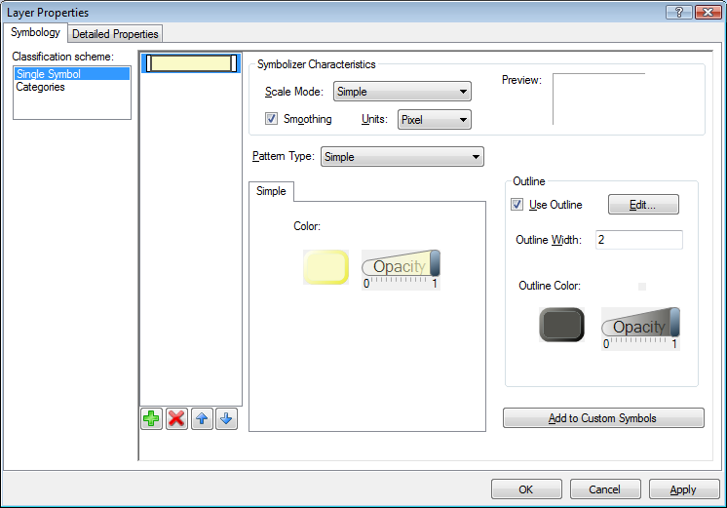
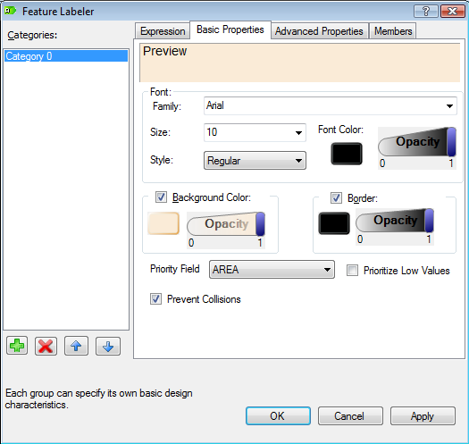
HydroDesktop GIS Capabilities
GIS
Hydrology
Add shapefiles to map
Change symbology and labels
Print and export map
GIS toolbox and Modeler
Search for data
Download data
Display time series
Export data

Slide 17
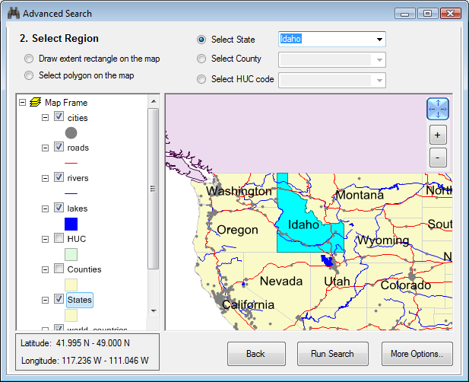
HydroDesktop Data Search
Search Criteria
Region
Keywords (variable)
Time range
Web services
Example:
Snow in Idaho
2000 - 2009
Notes:
User can search for available data by geographic region, variable, time range and web service. The variable, time range and web service criteria are optional.

Slide 18
HydroDesktop Data search – select region
Region selection
Draw bounding box
Select polygons
Select State
Select County
Select HUC Code
Notes:
User can search for available data by geographic region, variable, time range and web service. The variable, time range and web service criteria are optional.

Slide 19
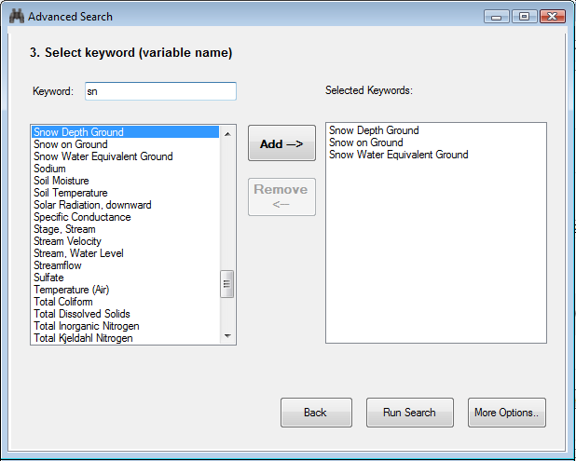
HydroDesktop Data search – select keywords
Notes:
One or more keywords can be selected. The list of available keywords is retrieved from HIS Central

Slide 20
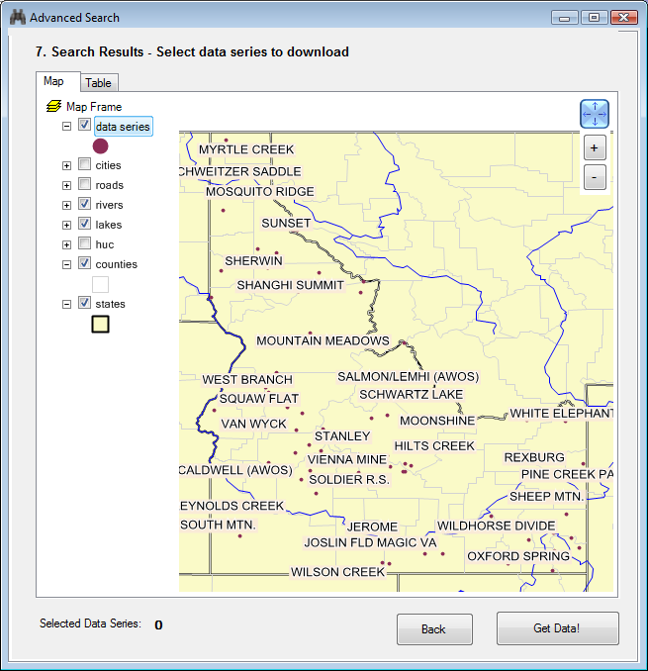
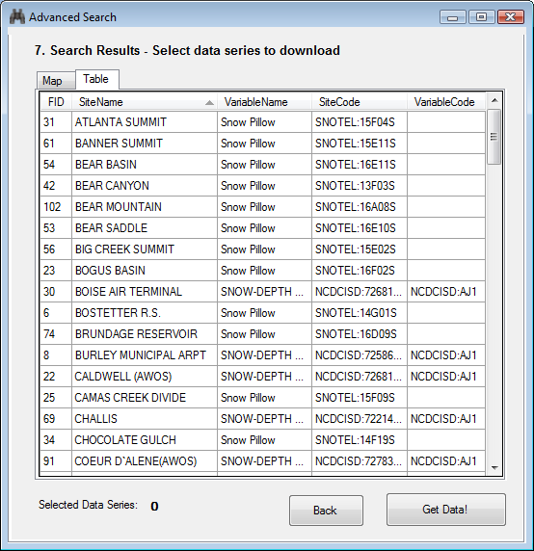
HydroDesktop Data search – Search Results
Snow - Idaho
Notes:
Search results are shown in a map and in a table. User can refine the search by selecting a subset of data series in the table or map.

Slide 21
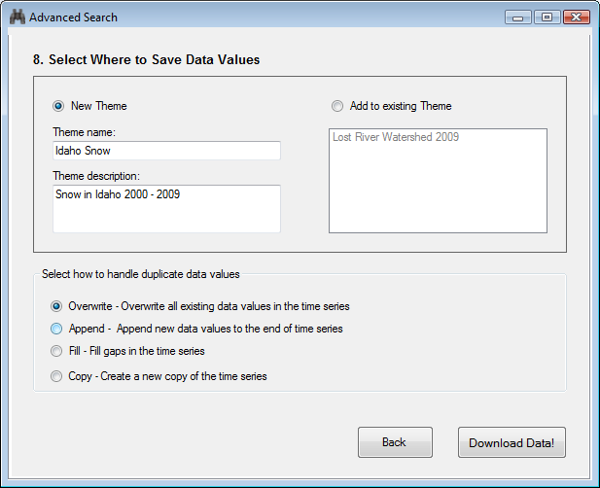
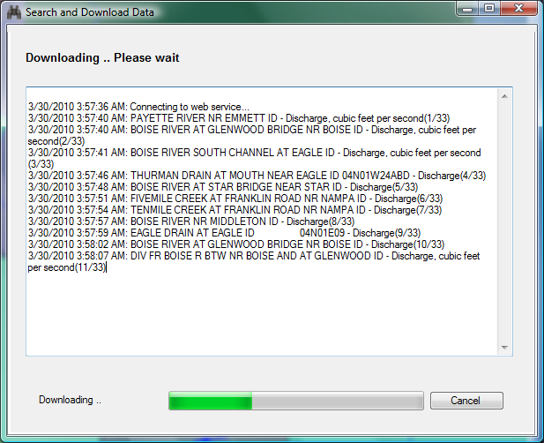
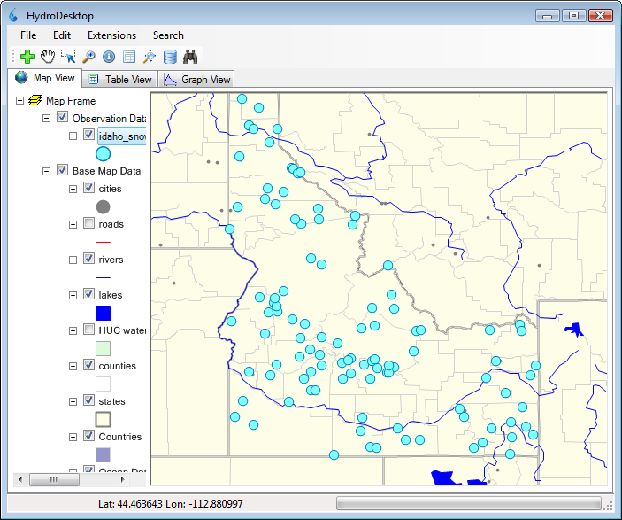
HydroDesktop Data Download
Notes:
After refining the search, HydroDesktop connects to one or more WaterOneFlow web services and downloads the observation data. The downloaded data is stored in a local SQLITE database. The measurement sites are displayed on the map as a new theme.

Slide 22
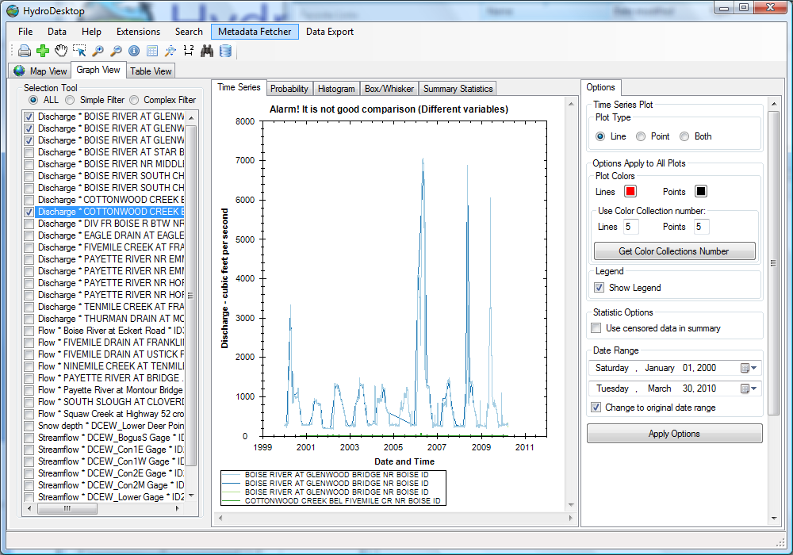
Graphing Capabilities

Slide 23
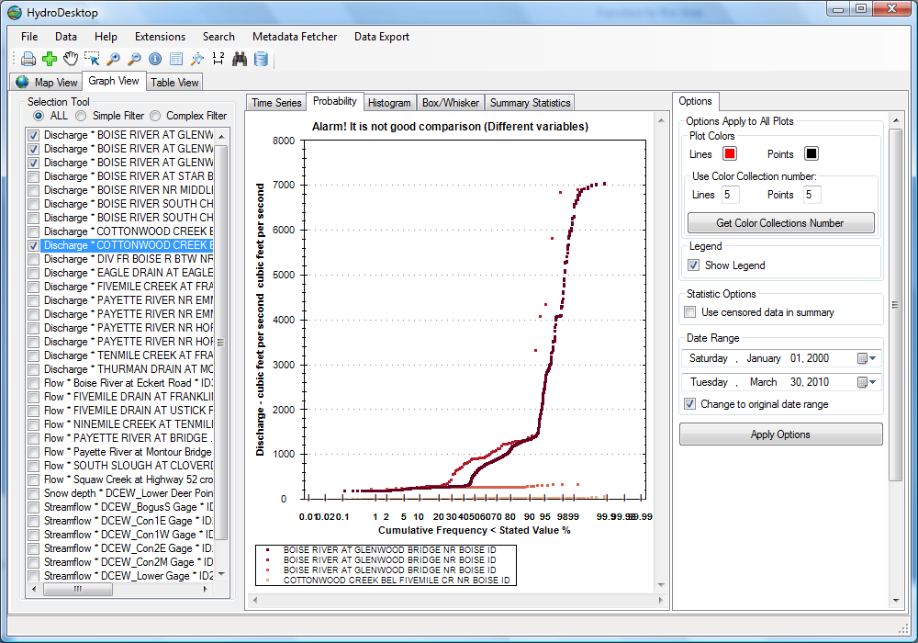
Graphing Capabilities

Slide 24
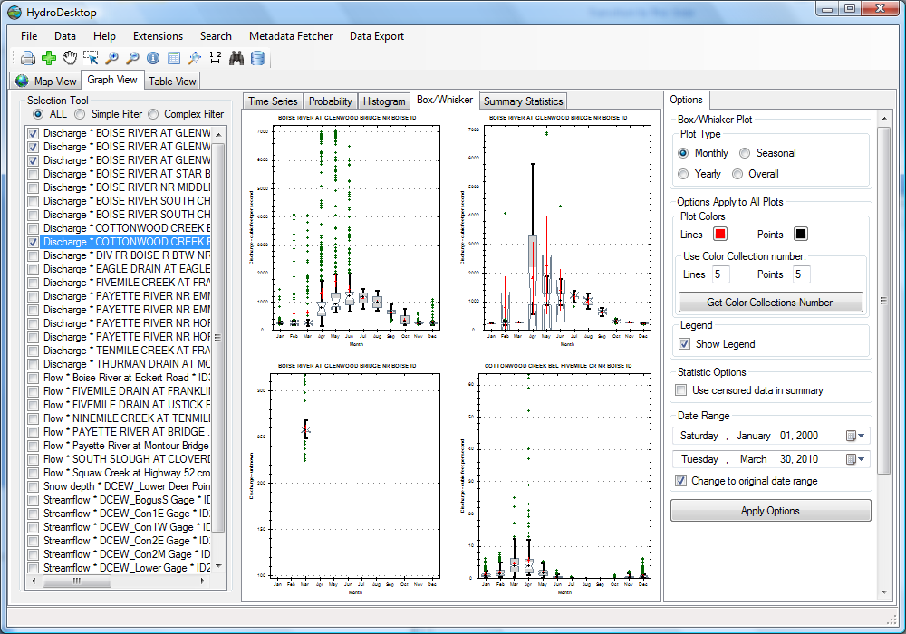
Graphing Capabilities

Slide 25
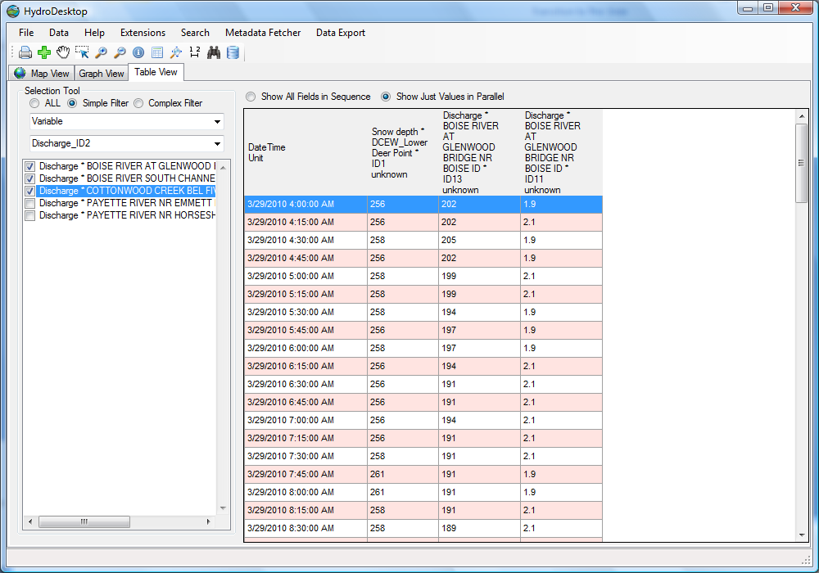
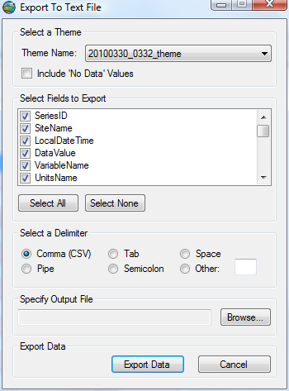
Tabular Data View

Slide 26
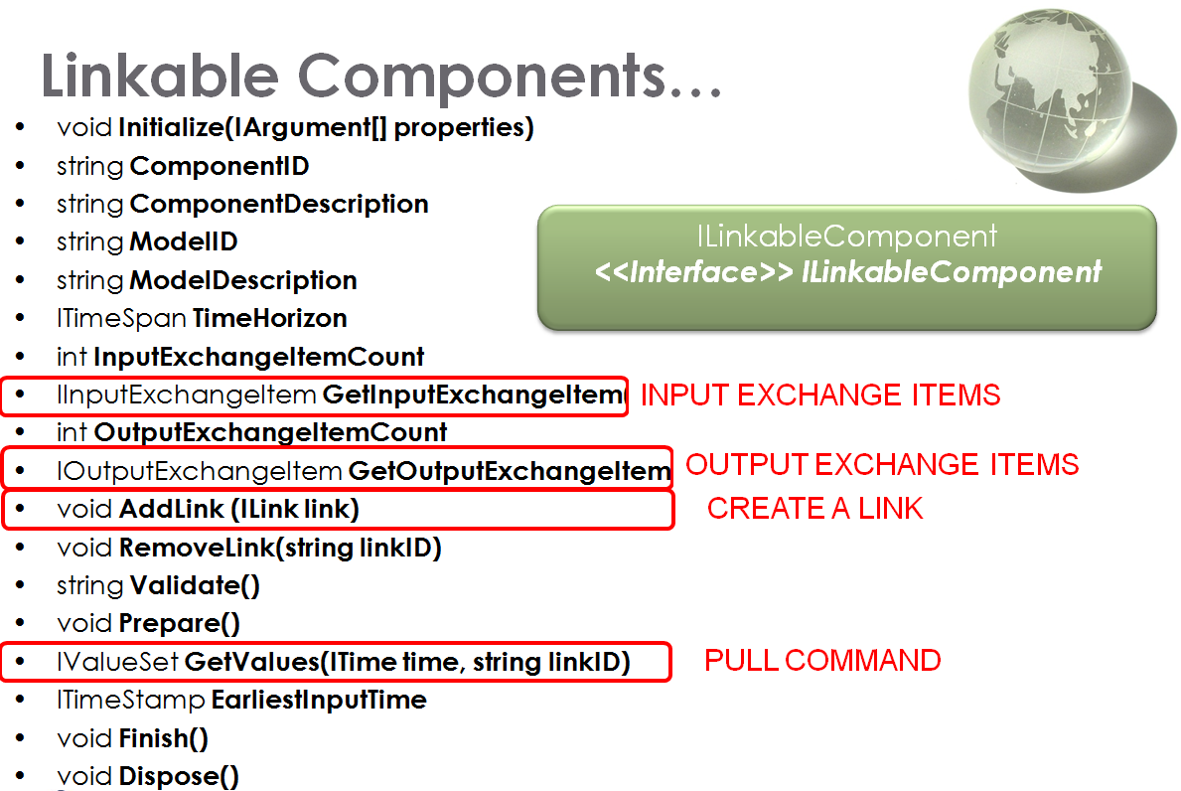
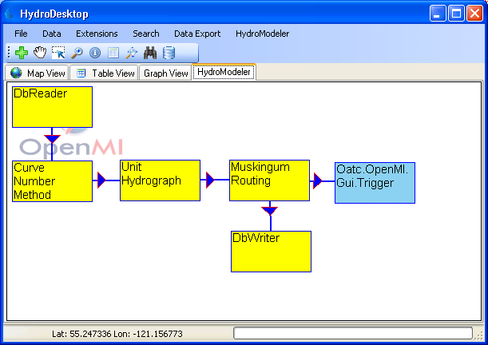
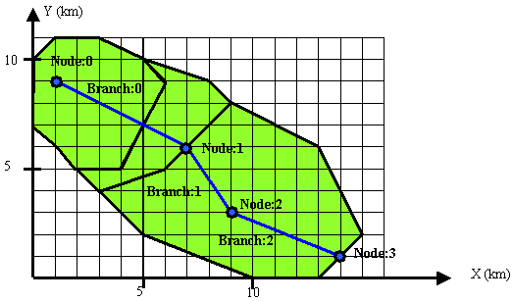
OpenMI HydroModeler

Slide 27


What’s Being Done for CZO…?
Idaho State University is leading the development of HydroDesktop including a set of CZO specific plugins for accessing data from CZO central and specific CZO data portal web sites.
CZO
HIS
OpenMI
Yang Cao, Idaho State University Visiting Scholar and CZO HydroDesktop programmer…
HydroDesktop

Slide 28
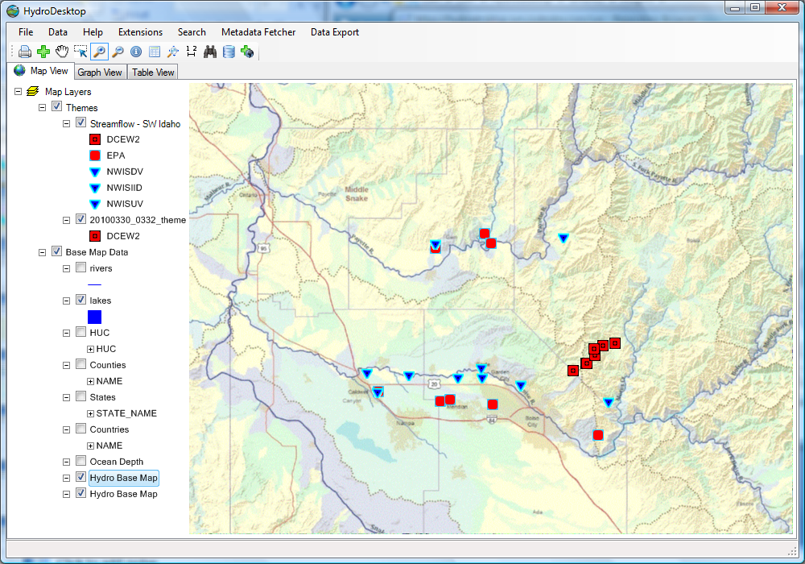
Enhanced Base Map from Online Data

Slide 29
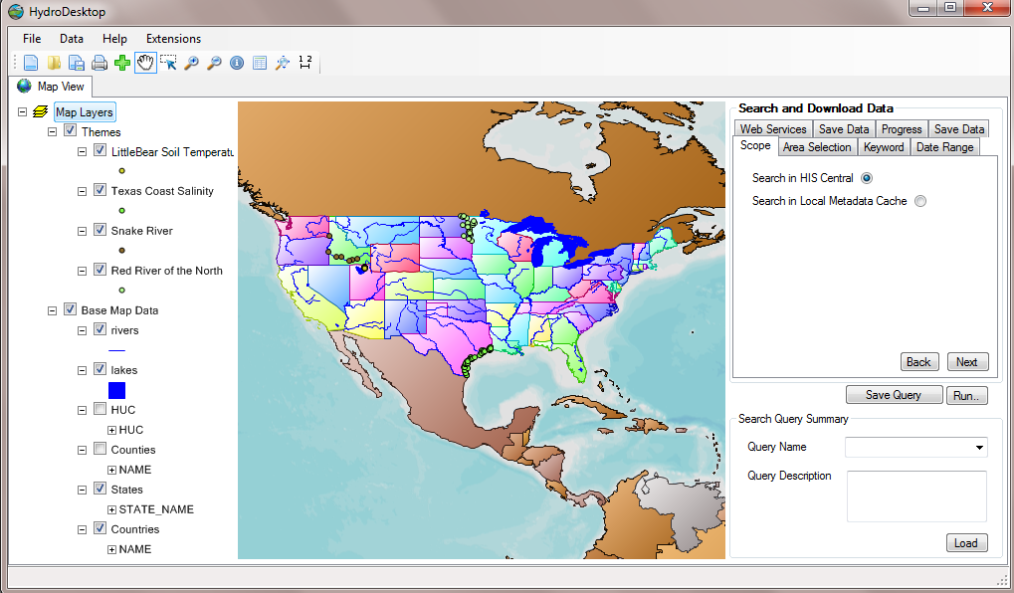
Streamlined GUI and Search
Search option integrated with Main Map View
Load Saved queries
SQL-Lite

Slide 30
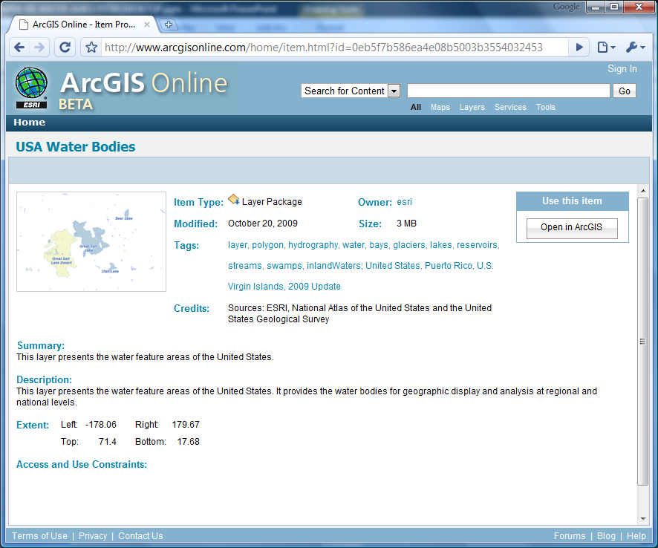
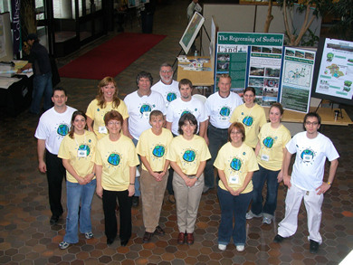

Integration with ArcGIS Online
CLIP ZIP
SHIP

Slide 31
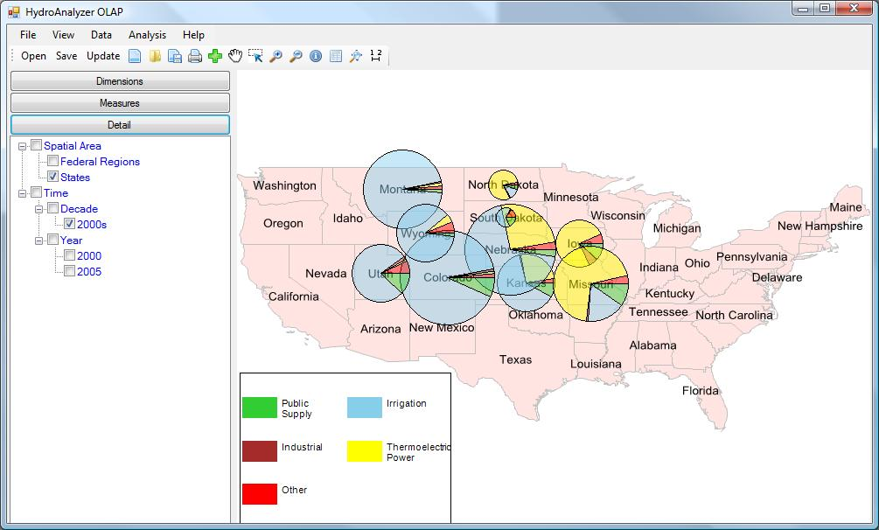
OLAP Data Cube Reanalysis and visualization:

Slide 32
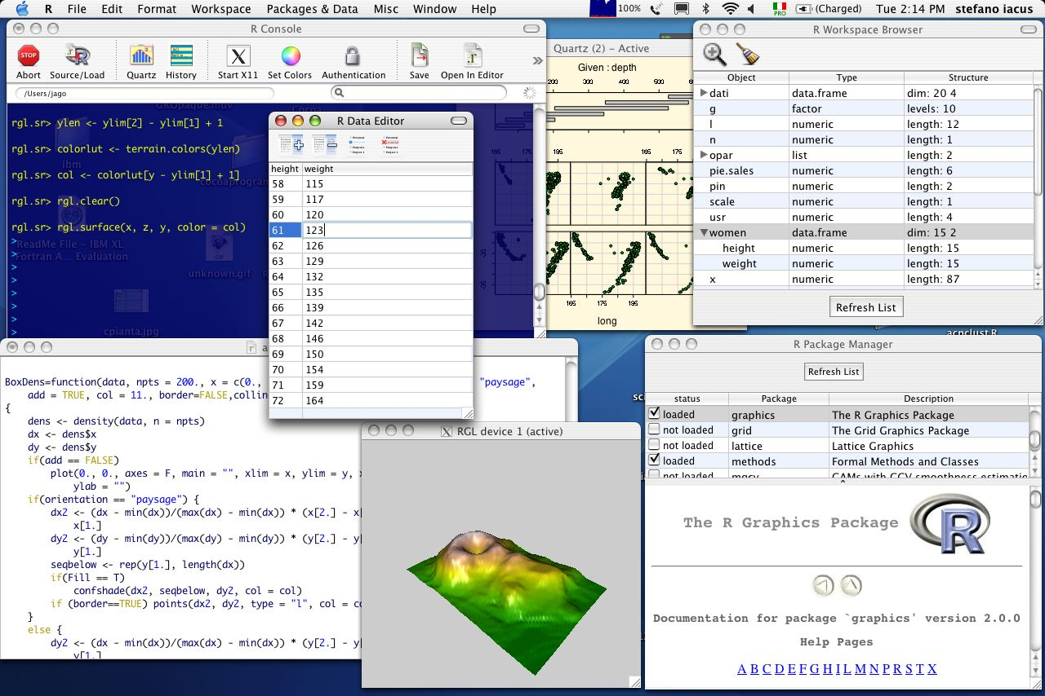
Integration with “R” Statistics Package

Slide 33
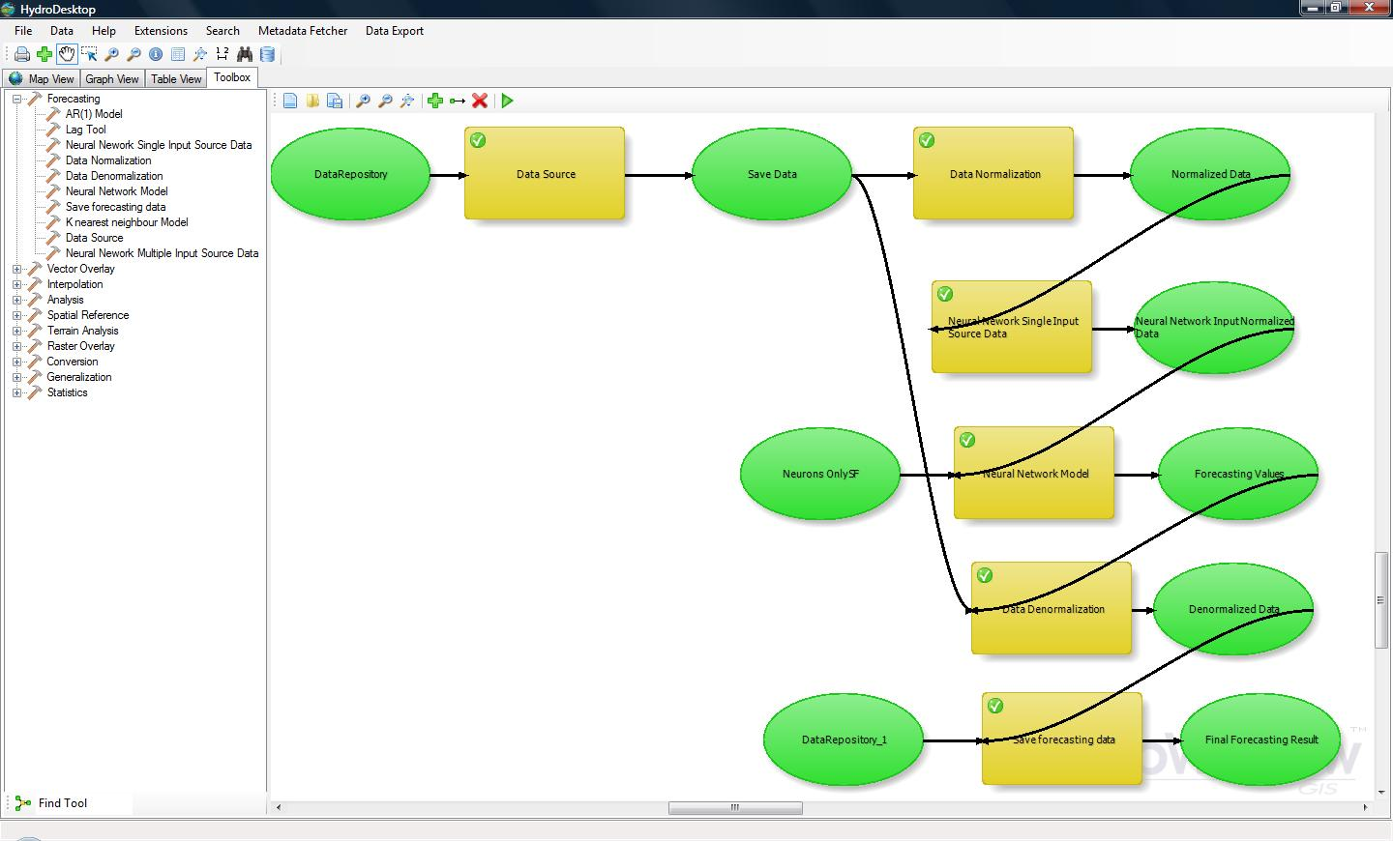
Integrated toolbox and ModelBuilder

Slide 34
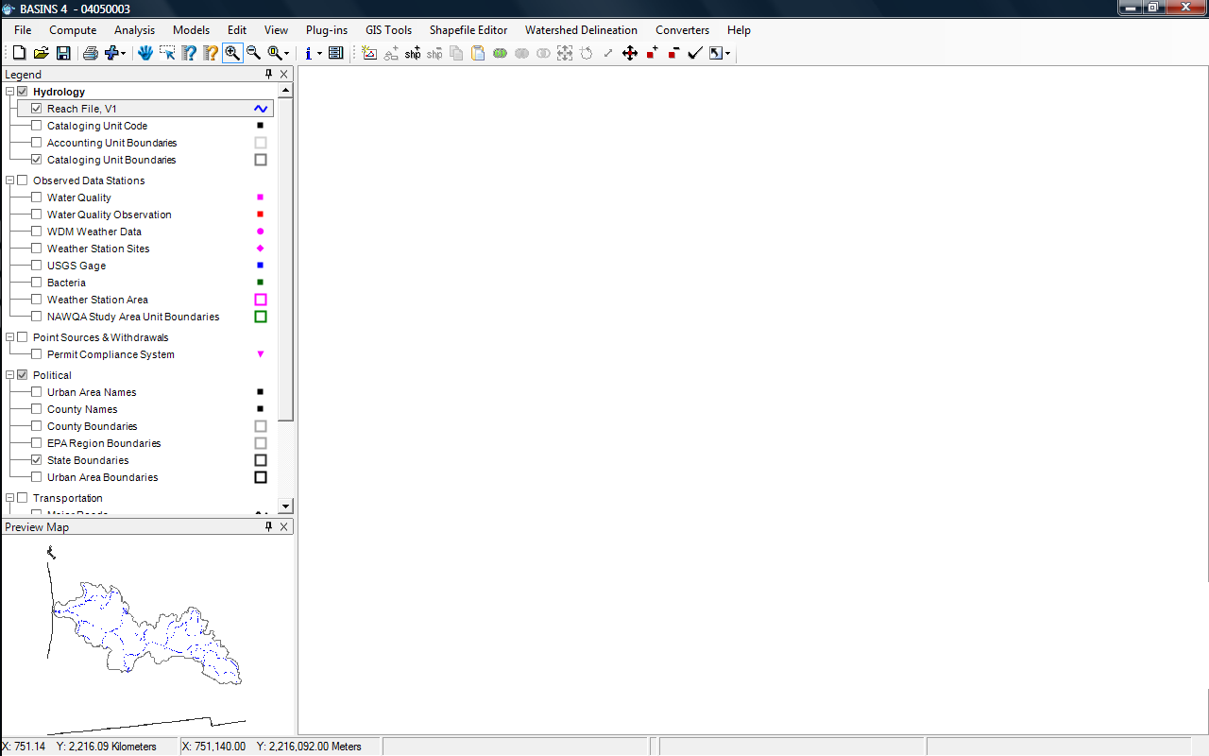
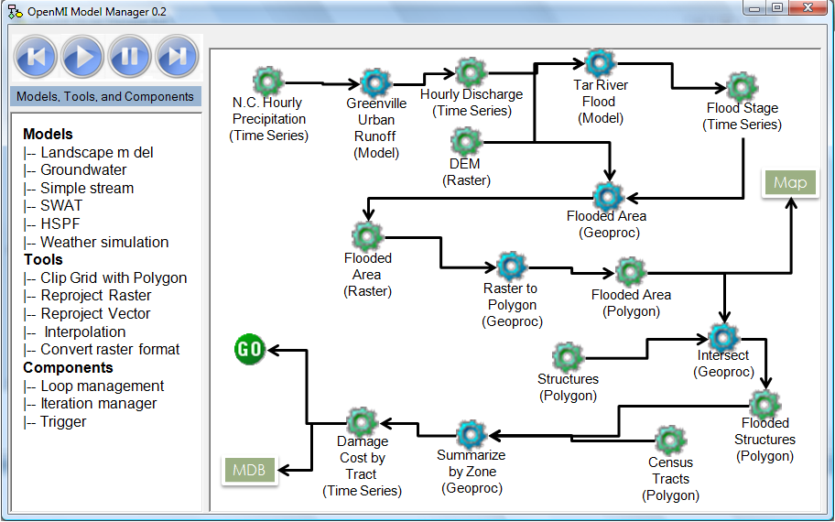
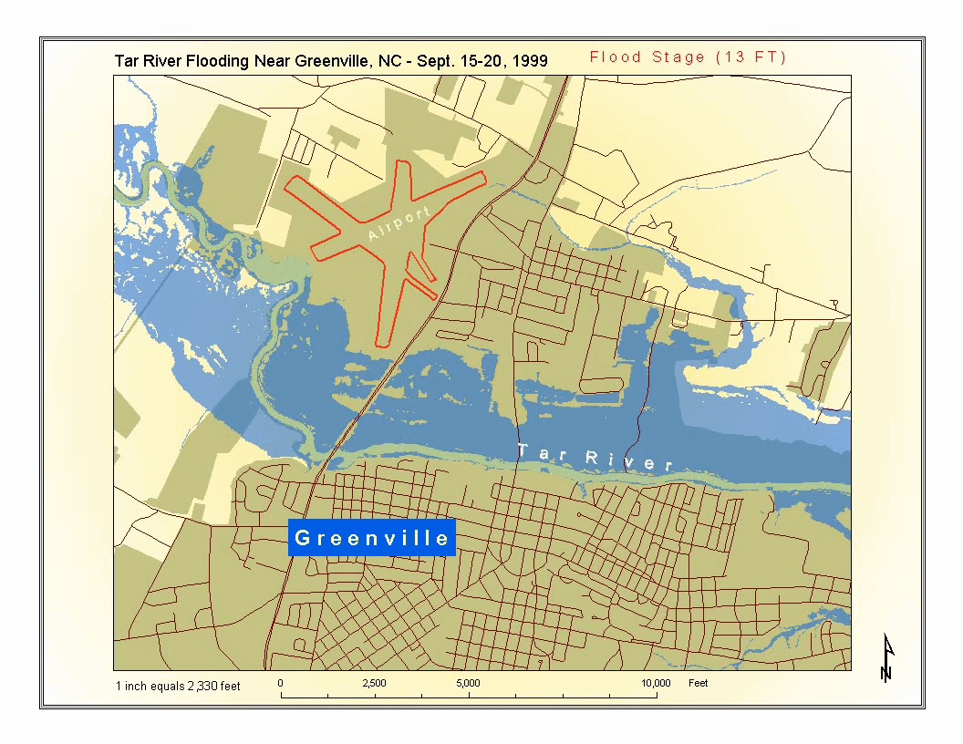
Integrated Time Series Modeling + GIS Environment
NOAA Coastal Services Center

Slide 35
HydroDesktop: A Key Component of the CUAHSI/CZO HIS for Hydrologic Data Discovery, Visualization, and Analysis
Daniel P. Ames, Ph.D. P.E.
Idaho State University
With Jiří Kadlec, Jeff Horsburgh, Yang Cao, and many others…

